Slide 1
Data Visualization
Presented by
Ankireddy Polu

Slide 2
A primary goal of data visualization is to communicate information clearly and efficiently via statistical graphics, plots and information graphics
Data Visualization Involves the creation and study of the visual representation of data

Slide 3
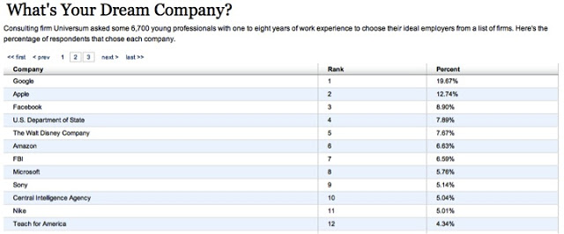

Slide 4
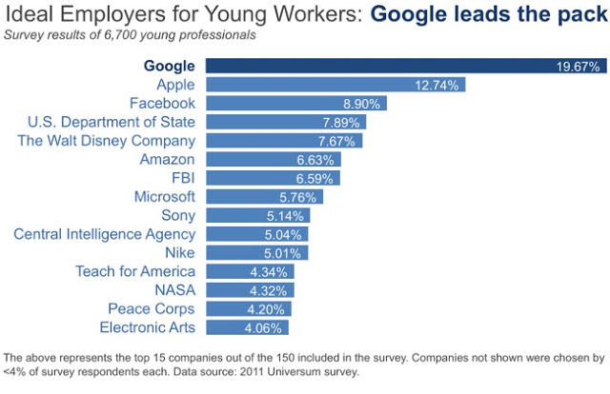

Slide 5
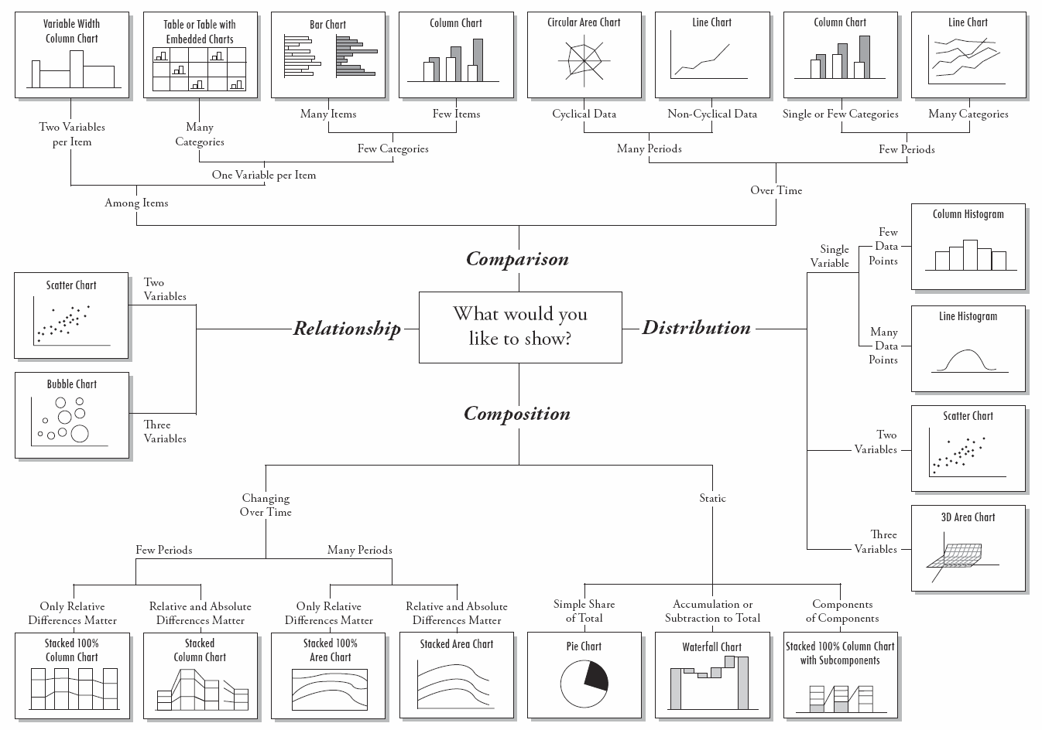
Find right chart for your data

Slide 6
Graphs for quantitative messages
Time-series: A single variable is captured over a period of time, such as the unemployment rate over a 10-year period. A line chart may be used to demonstrate the trend.
Ranking: Categorical subdivisions are ranked in ascending or descending order, such as a ranking of sales performance (the measure) by sales persons (the category, with each sales person a categorical subdivision) during a single period. A bar chart may be used to show the comparison across the sales persons.
Part-to-whole: Categorical subdivisions are measured as a ratio to the whole (i.e., a percentage out of 100%). A pie chart or bar chart can show the comparison of ratios, such as the market share represented by competitors in a market.

Slide 7
Graphs for quantitative messages
Deviation: Categorical subdivisions are compared against a reference, such as a comparison of actual vs. budget expenses for several departments of a business for a given time period. A bar chart can show comparison of the actual versus the reference amount.
Frequency distribution: Shows the number of observations of a particular variable for given interval, such as the number of years in which the stock market return is between intervals such as 0-10%, 11-20%, etc. A histogram, a type of bar chart, may be used for this analysis. A boxplot helps visualize key statistics about the distribution, such as median, quartiles, outliers, etc.
Correlation: Comparison between observations represented by two variables (X,Y) to determine if they tend to move in the same or opposite directions. For example, plotting unemployment (X) and inflation (Y) for a sample of months. A scatter plot is typically used for this message.

Slide 8
Graphs for quantitative messages
Nominal comparison: Comparing categorical subdivisions in no particular order, such as the sales volume by product code. A bar chart may be used for this comparison.
Geographic or geospatial: Comparison of a variable across a map or layout, such as the unemployment rate by state or the number of persons on the various floors of a building. A cartogram is a typical graphic used

Slide 9
Elastic search

Slide 10
Kibana

Slide 11
curl -H Content-Type:application/x-ndjson -XPUT localhost:9200/bank/account/_bulk --data-binary @accounts.json

Slide 12
References
https://en.wikipedia.org/wiki/Data_visualization
http://www.storytellingwithdata.com/blog/2011/11/visual-battle-table-vs-graph
https://www.labnol.org/software/find-right-chart-type-for-your-data/6523/

